Slide 1

KICP/AA Workshop
Session 3: Emerging technologies updates and Resource updates
11:45 AM -12:15 AM, ERC 576
January 30, 2020
rcc.uchicago.edu

Slide 2
Overview
ML/Deep learning at RCC
Midway3
The newly announced Intel OneAPI
Sharing, Reproducibility and Reusability of published data

Slide 3
ML/Deep learning at RCC

Slide 4
Software/DL Frameworks
Tensorflow:
module load Anaconda3/2019.03
module load cuda/10.0
conda activate tf-gpu-1.14.0
conda activate tf-gpu-2.0-cuda-10.0
PyTorch and PyTorch Geomteric
module load Anaconda3/2019.03
module load cuda/10.0
module load pytorch-gpu-1.2-cuda-10.0
pytorch-gpu-1.2-cuda-10.0+torch-geometric-1.3.2
Theano
module load Anaconda3/2019.03
conda activate theano-1.0.3

Slide 5
Example 1: Function approximation
GPU 1
Epoch

Slide 6
MidWay3

Slide 7
Midway3 Highlights
The procurement is in process. Award in February
Midway3 will be deployed this Spring with a new fast network architecture:
~ 200 Gb/s InfinBand core switch
Will use the latest processor technology

Slide 8
Intel OneAPI

Slide 9
Intel oneAPI
“One API is a project to deliver a set of developer tools that provide a unified programming model that simplifies development for workloads across diverse architectures."
Intel aims to deliver software solutions that allow developers to get the full performance out of the hardware including specialized accelerators.
The project’s purpose is to deliver a simple and scalable set of software tools that allow developers to create one source code base using a unified programming model and to then accelerate all or portions of that code by targeting the growing and diverse set of Intel processing architectures including scalar processors (CPUs), vector processors (GPUs), matrix processors (AI engines), and spatial processing elements (FPGAs).
One API supports direct programming and API programming, and will deliver a unified language and libraries that offer full native code performance across a range of hardware, including CPUs, GPUs, FPGAs and AI accelerators.

Slide 10
Intel oneAPI
Emerging number of workloads today require diverse computer architectures (CPU, GPU, AI, FPGA, and other accelerators) in order to deliver high compute performance
However, taking advantage of multiple types of architectures today is a challenge for developers
Programmers need reduced programming complexity
Image using a single software abstraction on a variety of architectures

Slide 11
Intel oneAPI
Data Parallel C++ (DPC++) is an evolution of C++ that incorporates SYCL*.
DPC++ allows code reuse across hardware targets,
enables high productivity and performance across CPU, GPU, and FPGA architectures, while permitting accelerator-specific tuning.

Slide 12
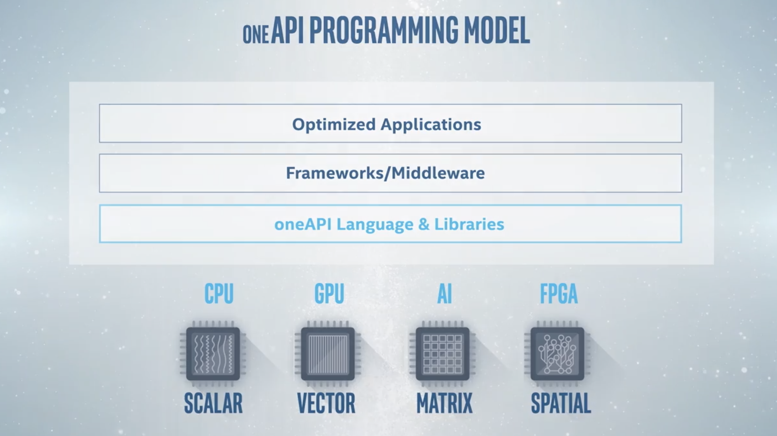
Test oneAPI on the Intel Dev Cloud at: software.intel.com/devcloud/oneapi

Slide 13
Sharing, Reproducibility and Reusability of published data

Slide 14
The data lifecycle
Acquire/Generate
Share/Publish
Store/Archive
Reproduce/Reuse
Process/Compute
Notes:
3 stages of research workflow
Data acquisition & cleaning & filtering
Data processing – running models
Data analysis – presenting outcomes

Slide 15
“An article … in a scientific publication is not the scholarship itself, it is merely advertising of the scholarship. The actual scholarship is the complete … set of instructions [and data] which generated the figures.” David Donoho/Jon Claerbout, 1998 (Victoria Stodden)
Acquire/Generate
Share/Publish
Store/Archive
Process/Compute
Notes:
David Leigh Donoho is a professor of statistics at Stanford University,

Slide 16

Reproducibility and Replicability
Reproducibility: Obtaining consistent results using the same input data, computational steps, methods, code, and conditions of analysis
-> not working on numerical reproducibility
Replicability: obtaining consistent results across studies aimed at answering the same scientific question, each of which has obtained its own data
Source: National Academies of Sciences, Engineering and Medicine. 2019.
Https://doi.org/10.17226/25303

Slide 17
Existing work and projects
Digital Object identifier (DOI): is a persistent identifier or handle used to identify digital objects uniquely.
Project jupyter: web application that allows you to create and share documents that contain live code, equations, visualizations and narrative text.
Containers: software to package applications allowing them to be portable to any system running a Linux OS. It captures necessary system dependencies and vastly help with reproducibility
Github/Gitlab: a web-based version-control and collaboration platform for software developers
Globus: software for transferring and sharing files with others. It is also used to build applications and gateways
Etc.
Notes:
GitHub is a web-based version-control and collaboration platform for software developers. ... GitHub, which is delivered through a software-as-a-service (SaaS) business model, was started in 2008 and was founded on Git, an open source code management system created by Linus Torvalds to make software builds faster

Slide 18
What question are we trying to address? How do we document and collect metadata/info about the methodology, data, software, tools, platform, etc. , associated with published results, research endeavors with minimum effort and produce artifacts that be can be reproducible
Notes:
Example: a researcher downloads a dataset, installs the used packages and tries to rerun the code

